Slide 1

Team Members:
Akhil Muniganti
Kasoju Sai Vineeth
Sandeep Kumar Reddy
Siva Prasad
Laxmi Reddy
NITIN EXPENSES ANALYSIS
Mentor: Sravani
Mentor
Sravani Velagada

Slide 2
INTRODUCTION
This project analyzes Nithin’s monthly income and spending pattern to understand why he is unable to save for buying a bike. Although Nithin earns a salary of ₹15,000, a major portion of his income is spent on less essential expenses. By categorizing expenses into essential and non-essential items and analyzing the data from the uploaded expense reports, this study identifies areas where costs can be reduced. The goal is to help Nithin manage his expenses better, increase savings, and make buying a bike financially achievable.

Slide 3
Agenda
1. a)How much is spent for each category? (Pivot Table)
b)Visually represent the amount spent against each category as what percentage of the total expense amount (Pivot Chart)
2. a)How much is spent on different items of each category? (Pivot Table)
b)Visually represent the amount spent on different items of Entertainment and Tickets and Bills category (Pivot Chart)
3. a)How many times money has been spent against different items of each category (Pivot Table)
b)Filter the data to display the data for Grocery items and Shopping items
4. a)What amount is spent on each item of the categories with highest and 2nd highest expense amount (Pivot Table)
b)Visually represent the data with data bars (Conditional Formatting)

Slide 4
5. a) Month-wise trend of expenses (Pivot Table and Chart)
b) Find out the month Nitin spent the most
6. a) Category-wise expenses (Pivot Table)
b) Visually represent it with data bars to display categories with the highest and lowest expense amount
7. a) Month-wise expense of each category (Pivot Table)
b) Find out 2 categories with higher expenses for each of the 6 months
8. a) How much is spent in each month against different items of Entertainment, Food, and Shopping categories (Pivot Table)
b) Find out which months have the highest amount spent for movies and dining out
9. a)Decide on the essential and less essential items and analyse the expenses
b)Recommend how Nitin can increase his savings

Slide 5
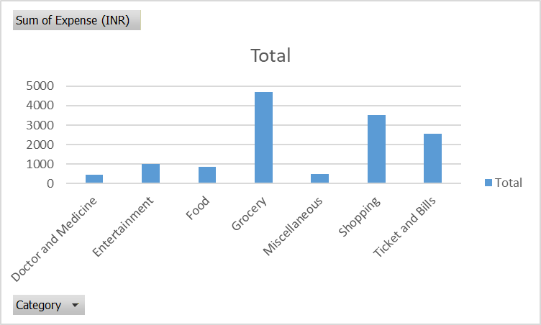
1. a) How much is spent for each category? (Pivot Table)
Row Labels | Sum of Expense (INR)
Doctor and Medicine | 450
Entertainment | 1000
Food | 850
Grocery | 4690
Miscellaneous | 500
Shopping | 3500
Ticket and Bills | 2570
Grand Total | 13560
The amount spent for each category is: Doctor & Medicine ₹450, Entertainment ₹1,000, Food ₹850, Grocery ₹4,590, Miscellaneous ₹500, Shopping ₹3,500, and Ticket & Bills ₹2,570.

Slide 6
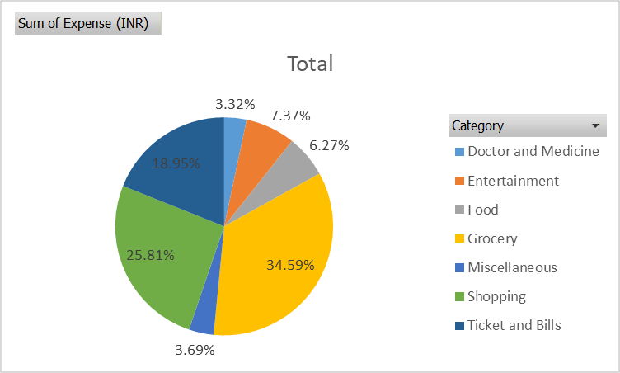
1. b)Visually represent the amount spent against each category as what percentage of the total expense amount (Pivot Chart)
Row Labels | Sum of Expense (INR)
Doctor and Medicine | 3.32%
Entertainment | 7.37%
Food | 6.27%
Grocery | 34.59%
Miscellaneous | 3.69%
Shopping | 25.81%
Ticket and Bills | 18.95%
Grand Total | 100.00%
The percentage-wise expense distribution shows that Grocery contributes the highest share (34.59%), followed by Shopping (25.81%) and Ticket & Bills (18.95%), while Doctor & Medicine has the lowest share (3.32%) of total expenses.

Slide 7
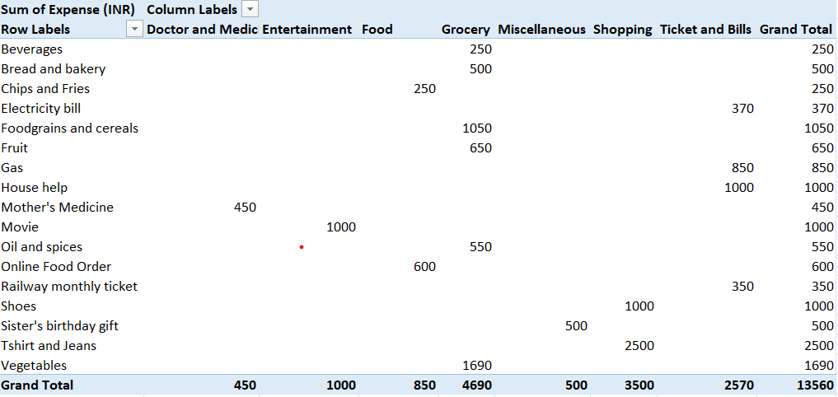
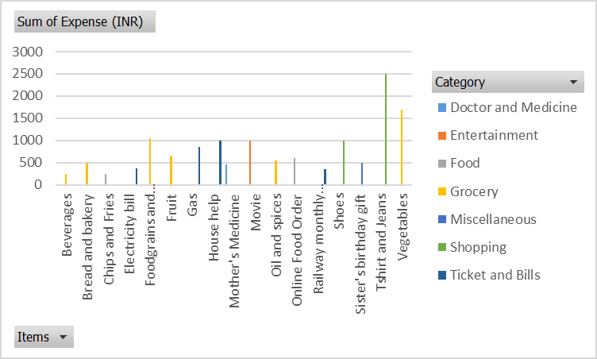
2. a)How much is spent on different items of each category? (Pivot Table)
The amount spent on different items of each category is as follows: groceries include vegetables (₹1,690), foodgrains & cereals (₹1,050), fruit (₹650), oil & spices (₹550), bread & bakery (₹500), and beverages (₹250); food includes online food orders (₹600) and chips & fries (₹250); shopping includes T-shirt & jeans (₹2,500) and shoes (₹1,000); ticket & bills include house help (₹1,000), gas (₹850), electricity bill (₹370), and railway monthly ticket (₹350); entertainment includes movies (₹1,000); doctor & medicine includes mother’s medicine (₹450); and miscellaneous includes sister’s birthday gift (₹500).

Slide 8
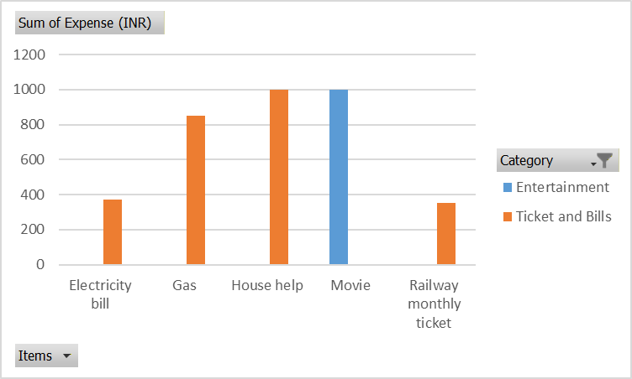
2. b)Visually represent the amount spent on different items of Entertainment and Tickets and Bills category (Pivot Chart)
Sum of Expense (INR) | Column Labels
Row Labels | Entertainment | Ticket and Bills | Grand Total
Electricity bill |  | 370 | 370
Gas |  | 850 | 850
House help |  | 1000 | 1000
Movie | 1000 |  | 1000
Railway monthly ticket |  | 350 | 350
Grand Total | 1000 | 2570 | 3570
The chart visually shows that Entertainment spending is entirely on movies (₹1,000), while Tickets & Bills expenses are mainly on house help (₹1,000), gas (₹850), electricity bill (₹370), and railway monthly ticket (₹350).

Slide 9
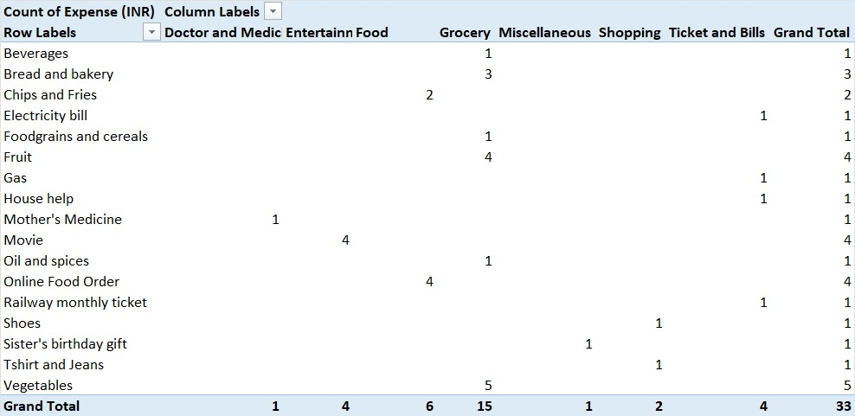
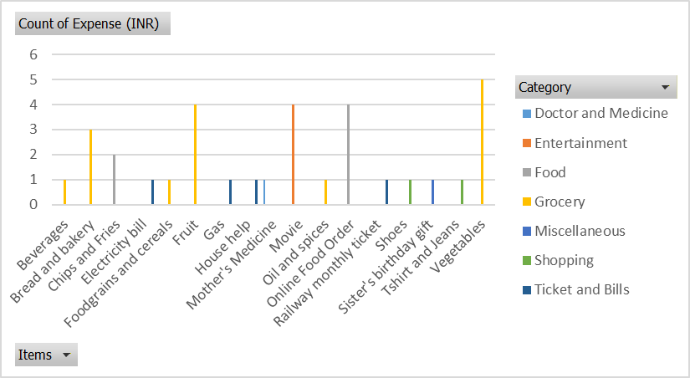
3. a)How many times money has been spent against different items of each category (Pivot Table)
The frequency analysis shows that money was spent most often on Grocery items (15 times), followed by Food (6 times), Entertainment and Ticket & Bills (4 times each), Shopping (2 times), while Doctor & Medicine and Miscellaneous were spent only once.

Slide 10
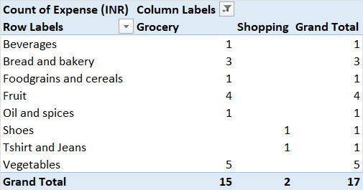
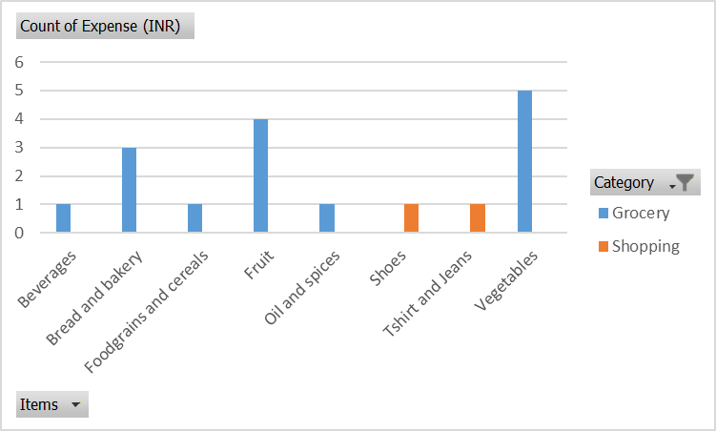
3. b)Filter the data to display the data for Grocery items and Shopping items?
After applying the filter, the analysis shows that Grocery items were purchased a total of 15 times, with vegetables (5 times), fruits (4 times), bread & bakery (3 times), and beverages, foodgrains & cereals, and oil & spices (1 time each), indicating frequent day-to-day spending on essentials. In contrast, Shopping items were purchased only 2 times, specifically for shoes (1 time) and T-shirt & jeans (1 time), showing that shopping expenses are less frequent and more occasional in nature.

Slide 11
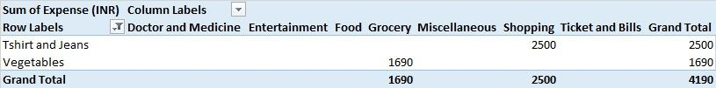
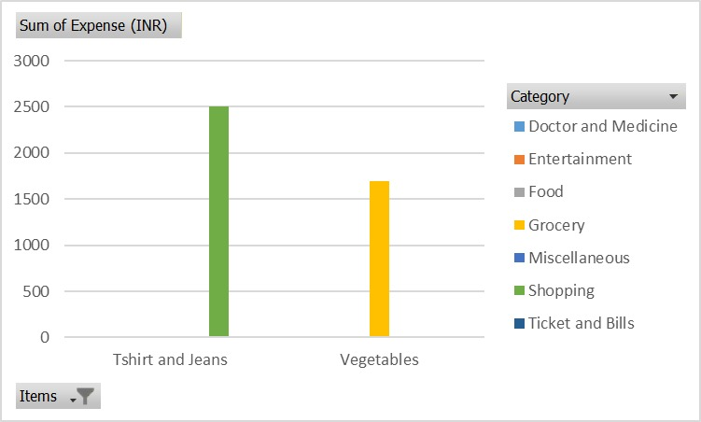
4. a)What amount is spent on each item of the categories with highest and 2nd highest expense amount (Pivot Table)
The category with the highest total expense is Shopping, where the amount spent on the item “T-shirt and Jeans” is ₹2,500, while the second-highest expense category is Grocery, in which the amount spent on the item “Vegetables” is ₹1,690. Together, these two items account for a combined expense of ₹4,190.

Slide 12
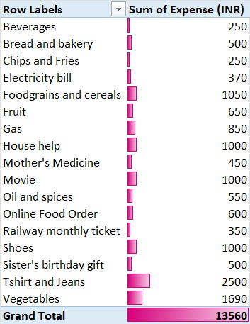
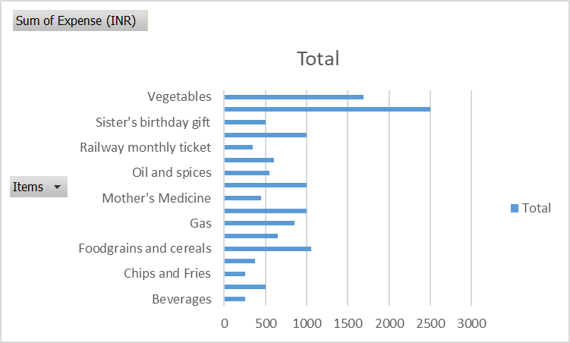
4. b)Visually represent the data with data bars (Conditional Formatting)
The data bars visually highlight the spending pattern across all items, showing that “T-shirt and Jeans” (₹2,500) and “Vegetables” (₹1,690) have the highest expenses, while items such as beverages, chips & fries, and electricity bill have comparatively lower spending, making it easy to identify high and low expense items at a glance.

Slide 13
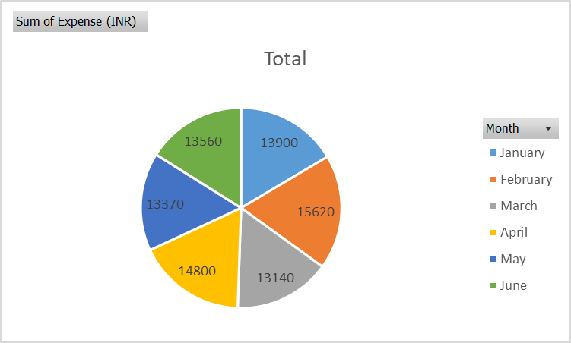
5. a) Month-wise trend of expenses (Pivot Table and Chart)
Row Labels | Sum of Expense (INR)
January | 13900
February | 15620
March | 13140
April | 14800
May | 13370
June | 13560
Grand Total | 84390
The month-wise expense trend shows that the highest spending occurred in February (₹15,620), followed by April (₹14,800), while the lowest spending was in March (₹13,140), indicating fluctuations in expenses across the months.

Slide 14
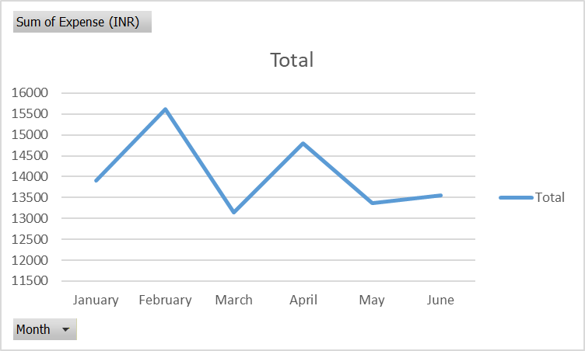
5. b) Find out the month Nitin spent the most?
Row Labels | Sum of Expense (INR)
February | 15620
Grand Total | 15620
Nitin spent the most in February, with a total expense of ₹15,620, making it the highest spending month.

Slide 15
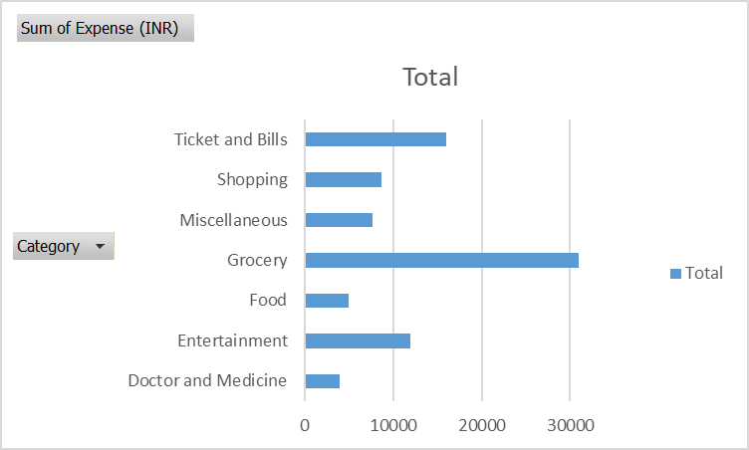
6. a) Category-wise expenses (Pivot Table)?
Row Labels | Sum of Expense (INR)
Doctor and Medicine | 4000
Entertainment | 12000
Food | 4940
Grocery | 30990
Miscellaneous | 7720
Shopping | 8700
Ticket and Bills | 16040
Grand Total | 84390
The category-wise expense analysis shows that Grocery has the highest total spending (₹30,990), followed by Ticket & Bills (₹16,040) and Entertainment (₹12,000), while Doctor & Medicine has the lowest expense (₹4,000).

Slide 16
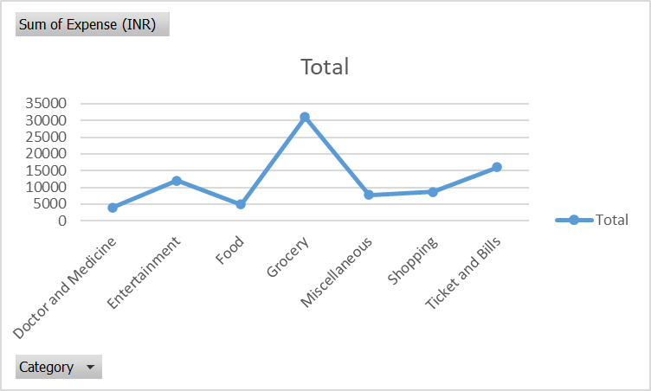
6. b) Visually represent it with data bars to display categories with the highest and lowest expense amount
Row Labels | Sum of Expense (INR)
Doctor and Medicine | 4000
Entertainment | 12000
Food | 4940
Grocery | 30990
Miscellaneous | 7720
Shopping | 8700
Ticket and Bills | 16040
Grand Total | 84390
The data bars clearly show that Grocery has the highest expense (₹30,990), while Doctor and Medicine has the lowest expense (₹4,000), making it easy to visually compare the highest and lowest spending categories.

Slide 17
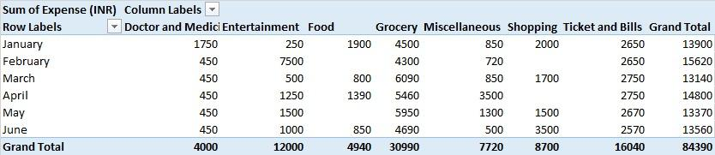
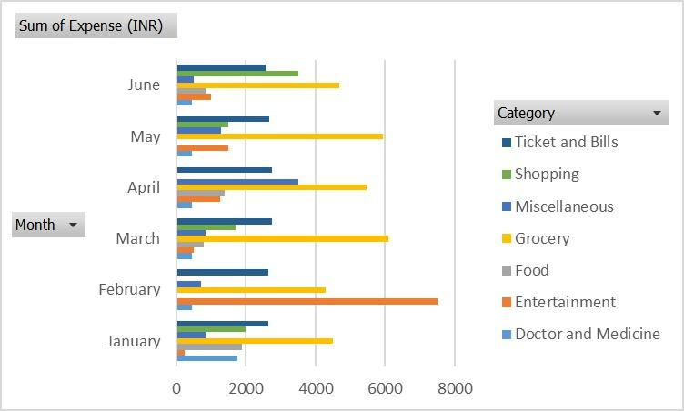
7. a) Month-wise expense of each category (Pivot Table)
Month-wise expenses show that Grocery is consistently high (₹4,300–₹5,950 per month), Entertainment peaks in February (₹7,500), Ticket & Bills range from ₹2,570–₹2,650 monthly, Food varies between ₹800–₹1,390, Shopping is occasional (₹1,500–₹2,000 in select months), while Doctor & Medicine stays constant at ₹450 and Miscellaneous remains low (₹500–₹850).

Slide 18
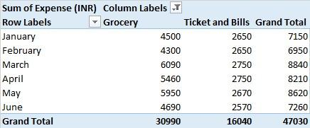
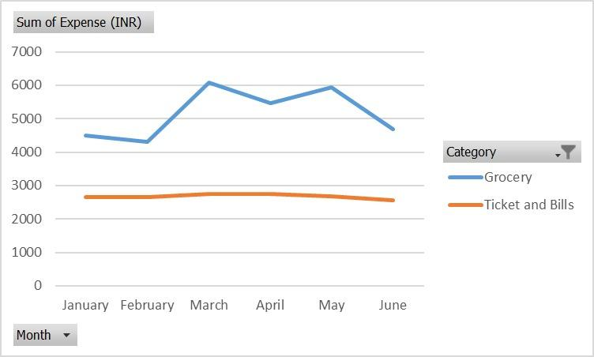
7. b) Find out 2 categories with higher expenses for each of the 6 months
For all 6 months, the two highest expense categories are Grocery and Ticket & Bills: Grocery ranges from ₹4,300 to ₹5,950 per month, while Ticket & Bills remain consistently high between ₹2,650 and ₹2,750, making them the top two spending categories every month.

Slide 19
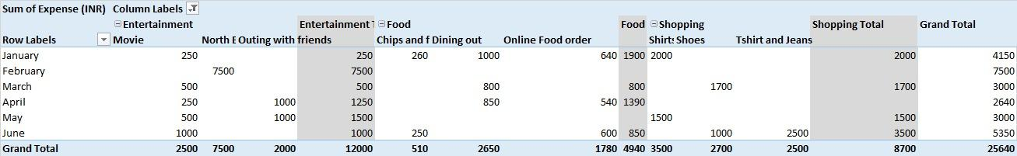
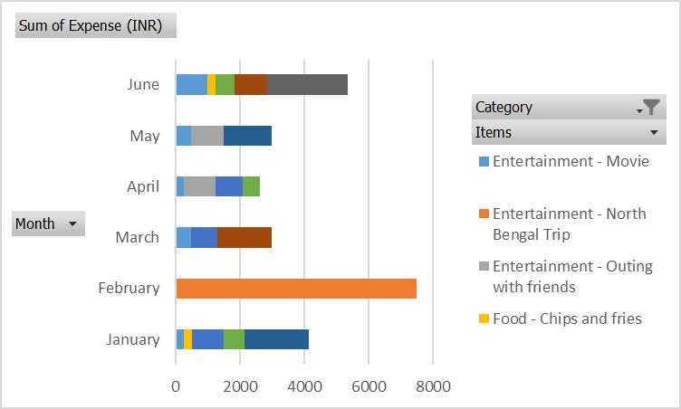
8. a) How much is spent in each month against different items of Entertainment, Food, and Shopping categories (Pivot Table)
The month-wise analysis shows that Entertainment spending is highest in February (₹7,500, mainly on movies), Food expenses vary each month with dining out and online orders ranging from ₹800 to ₹1,390, and Shopping expenses occur selectively with higher spending in April and June (₹2,000–₹3,500), mainly on T-shirts, jeans, and shoes.

Slide 20

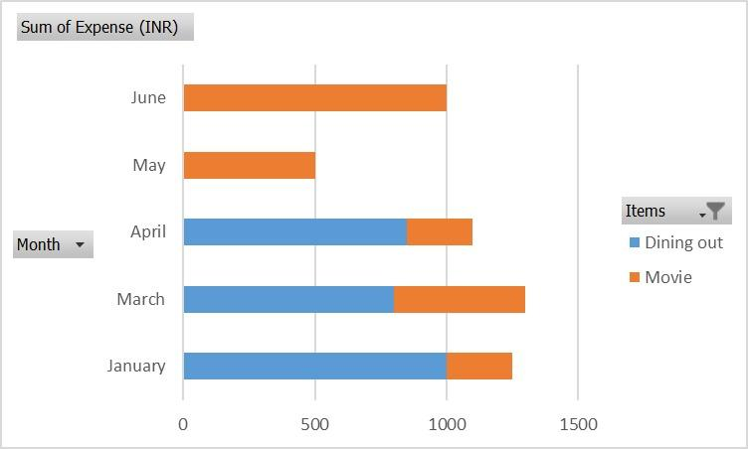
8. b) Find out which months have the highest amount spent for movies and dining out
The highest amount spent on movies is in February (₹1,000), while the highest spending on dining out is in March (₹800).

Slide 21
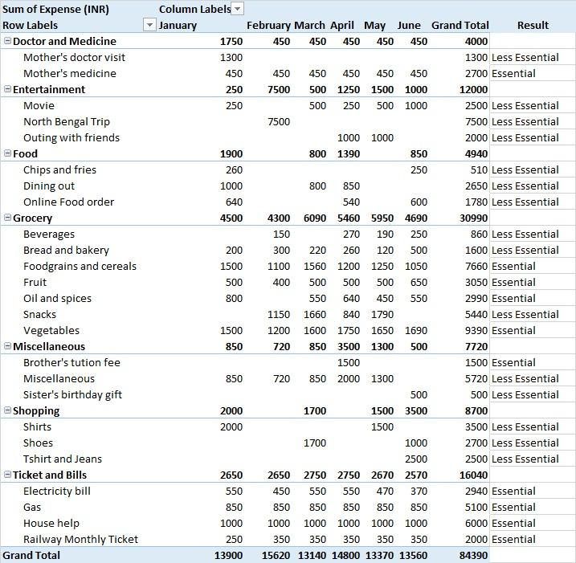
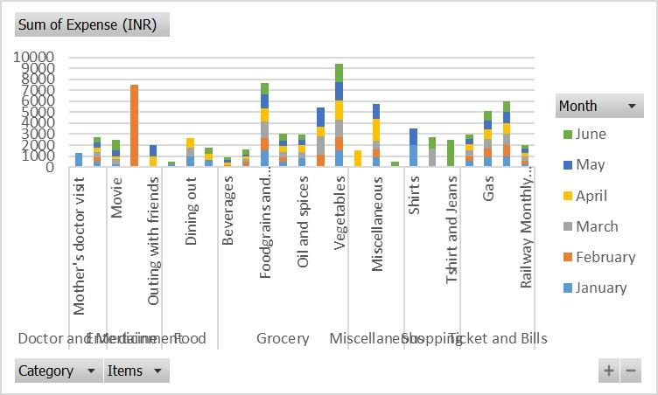
9. a)Decide on the essential and less essential items and analyse the expenses.
Essential expenses include groceries, medical needs, and fixed bills such as electricity, gas, house help, and tuition, as these are necessary and recurring. Less essential expenses include entertainment, dining out, online food orders, shopping, and gifts. The analysis shows that most spending is on essentials, while discretionary expenses form a smaller but controllable portion of the total.

Slide 22
9. b)Recommend how Nitin can increase his savings
Reduce spending on entertainment such as movies and outings.
Cut down on dining out and online food orders by preferring home-cooked meals.
Control shopping for clothes, shoes, and accessories by setting a budget.
Avoid frequent purchase of snacks, beverages, and fast food.
Restrict spending on gifts and celebrations to planned occasions.
Avoid luxury and non-urgent purchases and focus on essential needs.

Slide 23
Conclusion
From the expense analysis, it is evident that Nithin’s inability to buy a bike is mainly due to high spending on less essential items despite earning a steady salary of ₹15,000. By reducing unnecessary expenses and prioritizing essential needs, Nithin can significantly improve his savings. Proper budgeting, expense tracking, and controlled spending will help him allocate funds toward his goal. With disciplined financial planning, purchasing a bike becomes achievable within a short period.

Slide 24
Thank you

